Slide 1
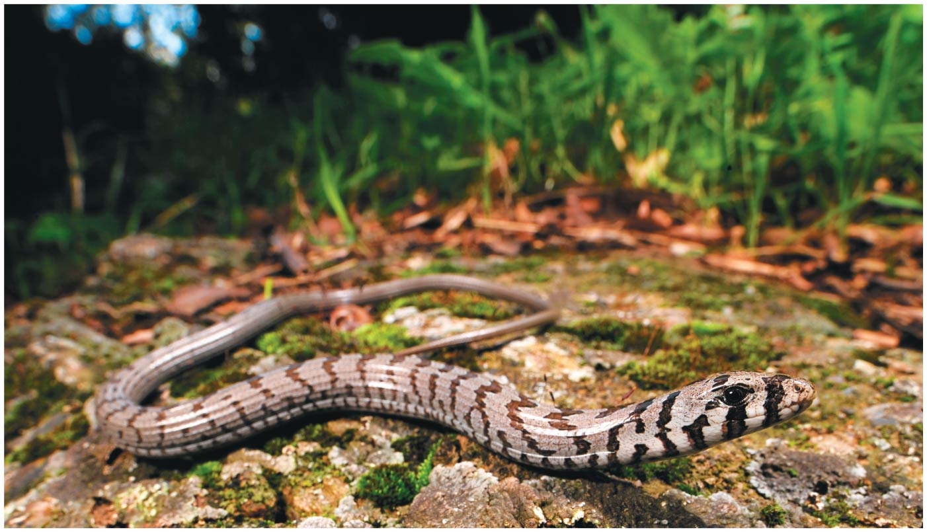
CH 26
LSU BIOL 1202
General Biology II Lecture
CHAPTER 26
Phylogeny and the Tree of Life
Dr. Adam Hrincevich
Notes:
Figure 26.1 What kind of organism is this?

Slide 2
CH 26 Learning Objectives
Define phylogeny and explain how phylogenies are used.
Explain how phylogenetic trees are inferred from data.
Differentiate between derived and ancestral characters and explain how they are used to construct phylogenetic trees.
Describe what evidence a genome provides about evolutionary history.
Explain what molecular clocks are and how they are used.
Describe the possible structure of the tree of all life.
Complete online cladogram construction example.
Complete practice exercises posted to MOODLE
I would suggest completing the crossword puzzle to help you understand the terminology and correlate how the terms relate to topics covered in this chapter.

Slide 3
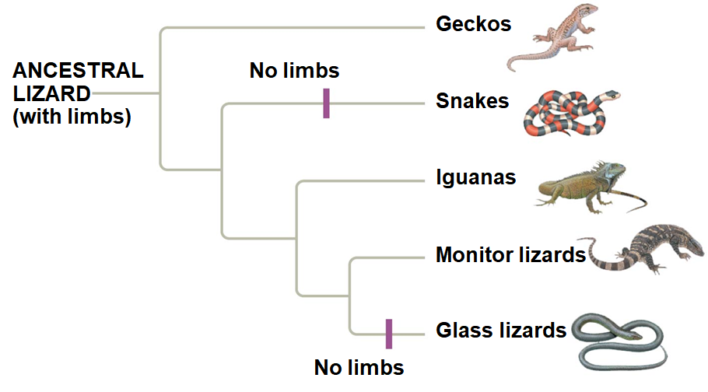
Investigating the Tree of Life
Phylogeny is the evolutionary history of a species or group
  EX: A phylogeny shows that legless lizards and snakes evolved from
The discipline of systematics classifies organisms and
Notes:
Figure 26.2 Convergent evolution of limbless bodies

Slide 4
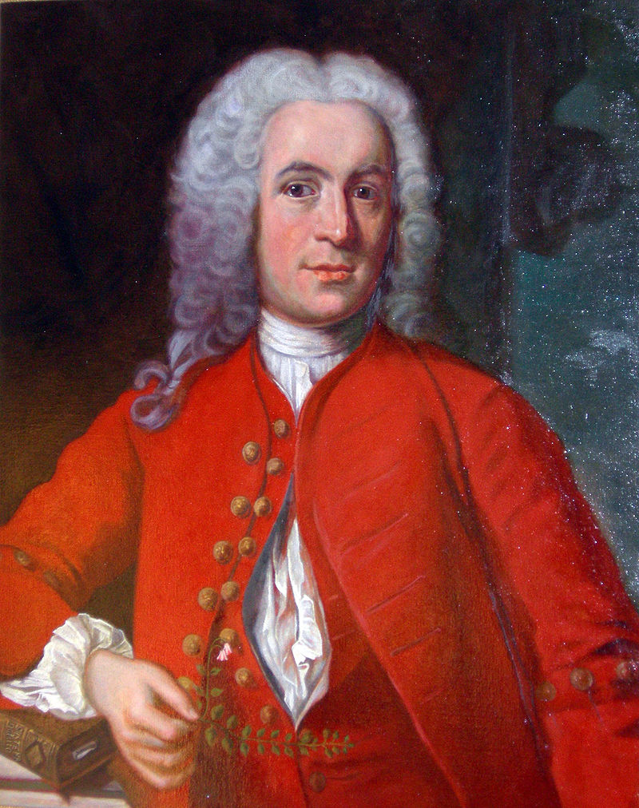
Binomial Nomenclature
Concept 26.1: Phylogenies show evolutionary relationships
In the 18th century, Carolus Linnaeus published a
Two key features of his system remain useful today:

Slide 5
5
The two-part scientific name of
The first part
The second part, called the specific epithet, is unique for
The first letter of the genus is capitalized, and the entire
Both parts together describe the scientific name or
EX:

Slide 6
Hierarchical Classification
Linnaeus introduced a system for grouping species in increasingly
The taxonomic groups from broad to narrow are
A taxonomic unit at any level of
The broader taxa are
  EX: An order of snails has less genetic diversity than
Categories become more

Slide 7
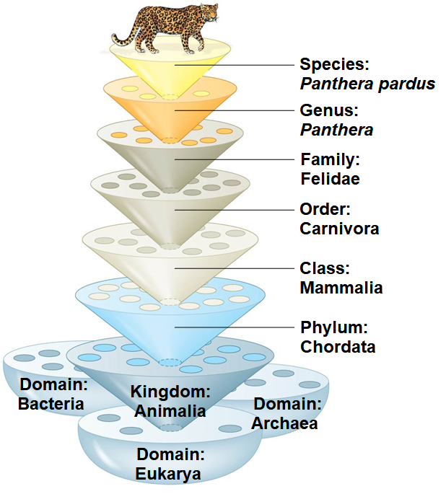
Figure 26.3
Notes:
Figure 26.3 Linnaean classification

Slide 8
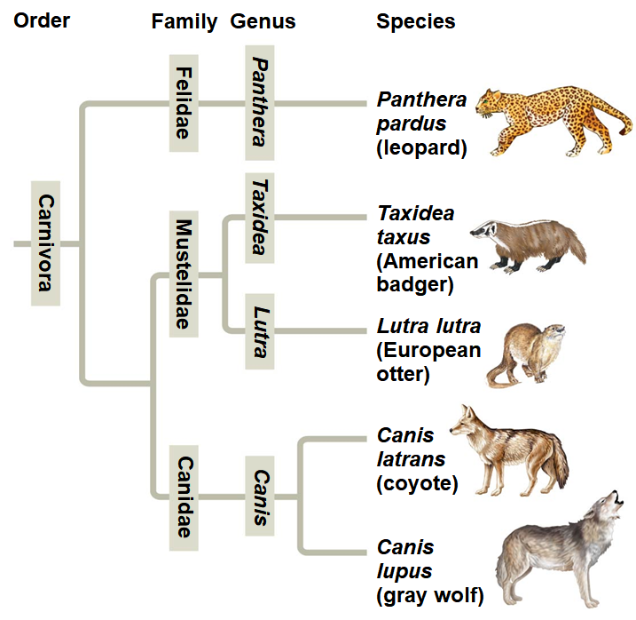
Linking Classification and Phylogeny
The evolutionary history of a group of organisms can be represented in a
The "tips" of the tree branches represent
Notes:
Figure 26.4 The connection between classification and phylogeny

Slide 9
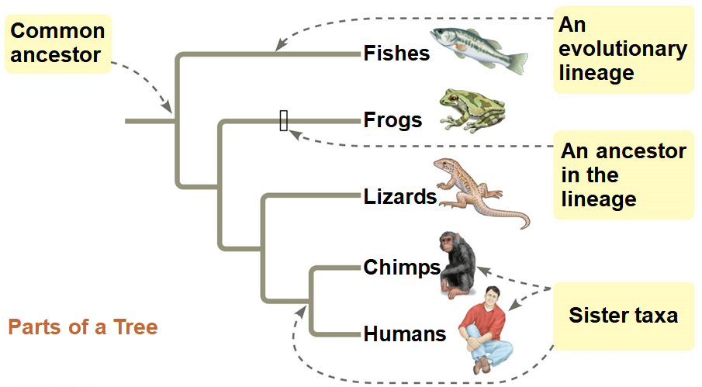
What We Can and Cannot Learn from Phylogenetic Trees
A phylogenetic tree represents a
Each branch point represents the divergence of two evolutionary
Sister taxa are groups that share an immediate common ancestor that is
Notes:
Figure 26.5a Visualizing phylogenetic relationships (part 1: parts of a tree)

Slide 10
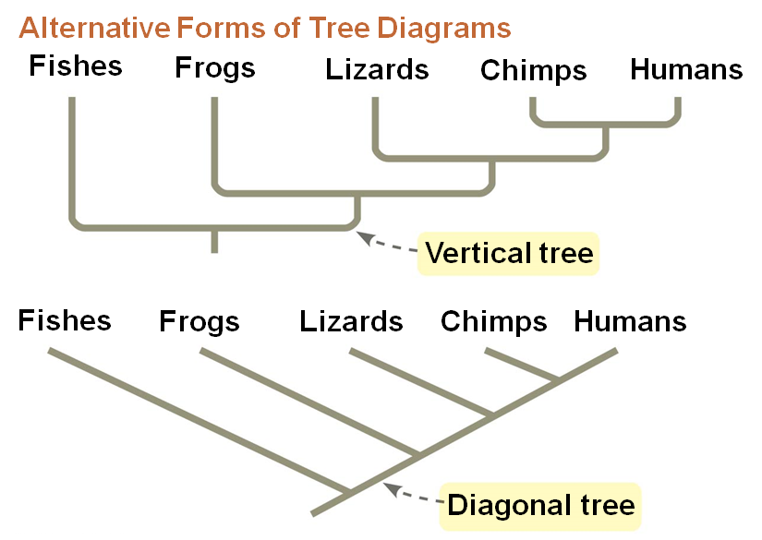
10
Phylogenetic trees can be drawn horizontally, vertically, or diagonally without
Notes:
Figure 26.5b Visualizing phylogenetic relationships (part 2: alternative forms of tree diagrams)

Slide 11
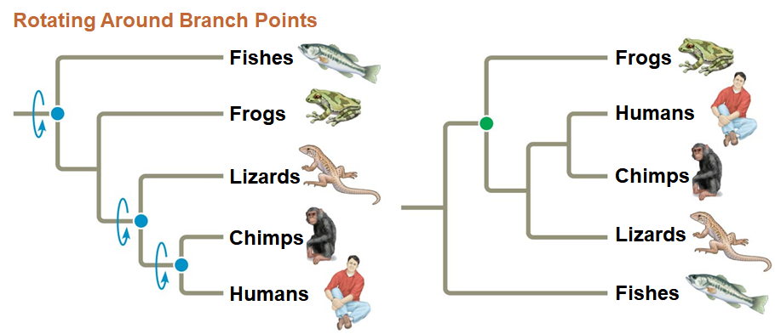
11
Tree branches can be rotated around a branch point without
  EX: the tree below depicts the
Phylogenetic trees show patterns of
Phylogenetic trees do not indicate when species evolved
It should not be assumed that a
Tree tutorial
GOOD EXAM QUESTION COMPARING TREES FOR EQUALITY
Tree tutorial
Notes:
Figure 26.5c Visualizing phylogenetic relationships (part 3: rotating around branch points)

Slide 12
Concept 26.2: Phylogenies are inferred from morphological and molecular data
To infer phylogenies, systematists gather information about the
Phenotypic and genetic similarities due to shared ancestry
Organisms with similar morphologies or DNA sequences are likely to be
  #1: 5’-ATGGGGTATATCGCC-3’
  #2: 5’-ATGGGATAAATCGCG-3’
  #3: 5’-ATGGGGTATATGGCC-3’
3 changes
more closely
related than
#1 & #2 or
#2 & #3
1 change
4 changes

Slide 13
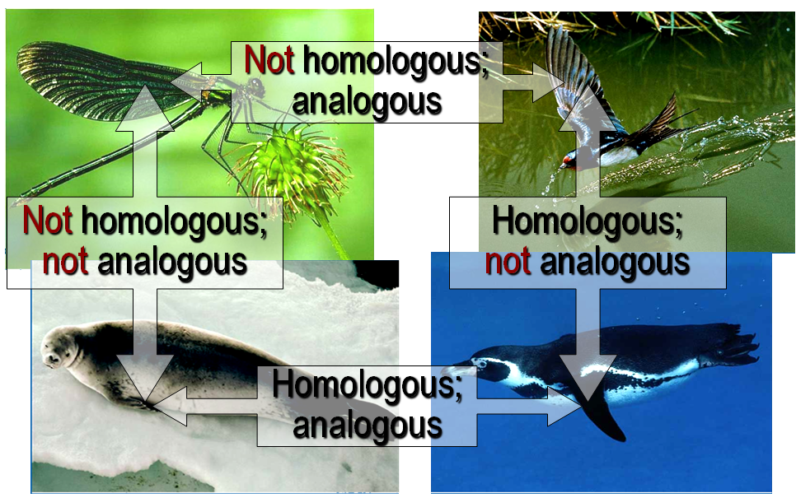
Sorting Homology from Analogy
Systematists need to determine if a similarity is the result of
  Homology is
  Analogy is

Slide 14
14
Convergent evolution is when different taxa/species solve a problem in the same way evolutionarily. This examines
  EX:
  Similar function/use, but
  Both used for locomotion. Humans use muscles/tendons, while
Divergent evolution is the process by which an ancestral characteristic becomes adapted to new roles. This examines
  EX:
  Similar structure or anatomy, but
  Both look like they are “arm” structures. Humans

Slide 15
Concept 26.3: Shared characters are used to construct phylogenetic trees
Once homologous characters have been identified, they can be
Cladistics groups organisms by
A clade is a group of species that includes an
Clades can be nested in

Slide 16
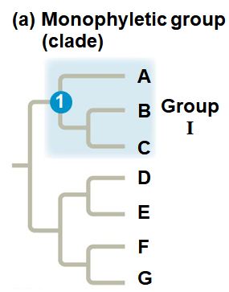
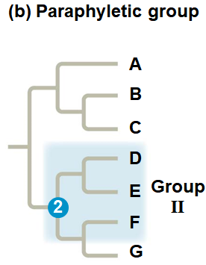
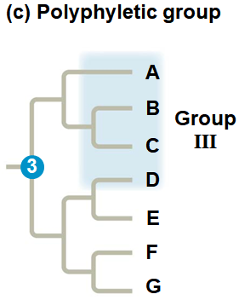
16
A valid clade is monophyletic, signifying that it consists of
A paraphyletic grouping consists of an ancestral species and
A polyphyletic grouping includes distantly related species but does not
Notes:
Figure 26.10 Monophyletic, paraphyletic, and polyphyletic groups

Slide 17
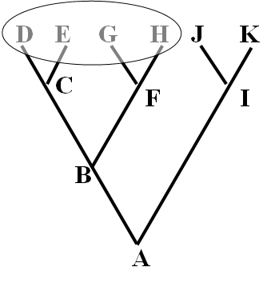
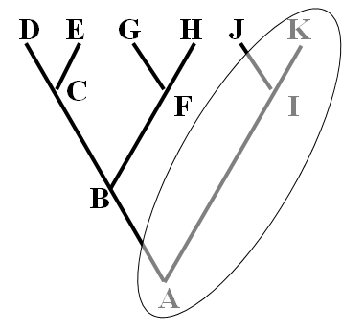
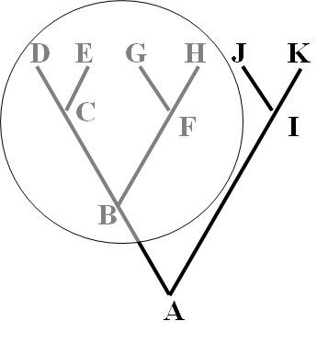
17
POLYPHLYLETIC
PARAPLYLETIC
MONOPLYLETIC?
POLYPHLYLETIC?
PARAPLYLETIC?
#1
#2
MONOPLYLETIC
GOOD EXAM QUESTION COMPARING TREES WITH VARIOUS GROUPS CIRCLED
#3

Slide 18
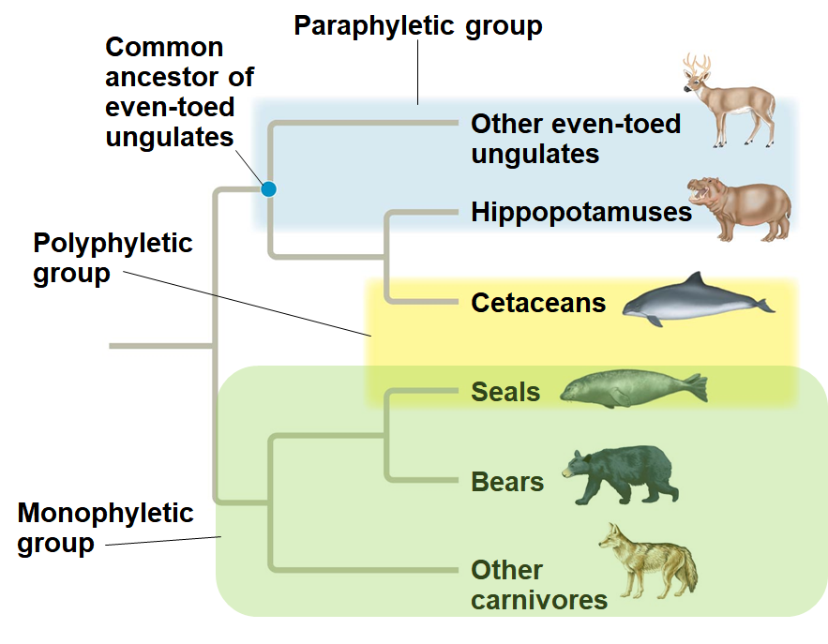
Figure 26.11
You should be able to identify the different types of PHYLETIC groupings
Notes:
Figure 26.11 Examples of a paraphyletic and a polyphyletic group

Slide 19
Shared Ancestral and Shared Derived Characters
In comparison with its ancestor, an organism has both
A shared ancestral character is a
A shared derived character is an
A character can be both

Slide 20
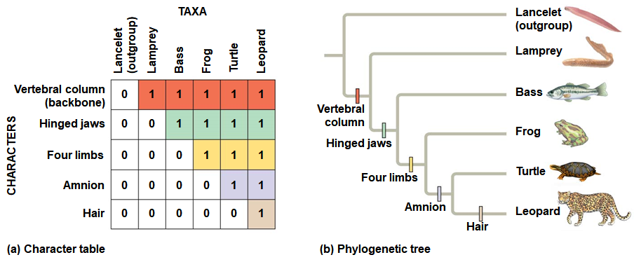
Inferring Phylogenies Using Derived Characters
When inferring evolutionary relationships, it is useful to know in which
Notes:
Figure 26.12 Using derived characters to infer phylogeny

Slide 21
21
An outgroup is a species or group of species that is closely related to
The outgroup is a group that has
Systematists compare each ingroup species with the outgroup to differentiate between
Characters shared by the outgroup and ingroup are ancestral characters that

Slide 22
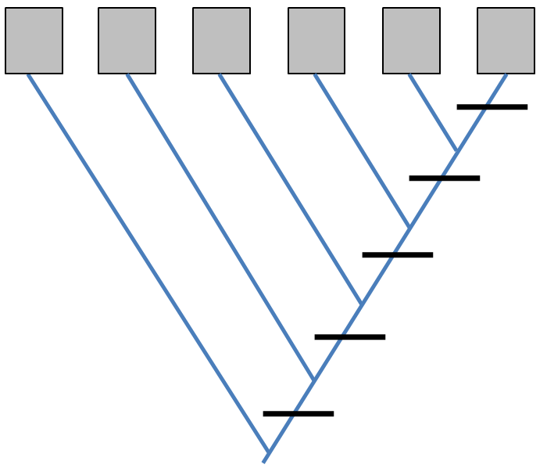
22
Tree Building Activity
 | Thick Hooves (1) | Big Teeth (2) | Soft Fur (3) | Squeeky Voice (4) | Red Nose (5)
Dasher (D) | Y | N | Y | N | N
Prancer (P) | N | Y | N | Y | N
Vixen (V) | N | Y | N | N | N
Comet (C) | Y | N | N | N | N
Rudolph (R) | Y | N | Y | N | Y
Blitzen (B) | Y | Y | N | N | N
*** For cladistic purposes, Rudolph will be considered the OUTGROUP since he is the OLDEST
Based on the information in the table below, construct a cladogram (or family tree) that depicts the relatedness of Christmas reindeer based on ancestral or derived characters. Place each of the reindeer "D, P, V, C and B" in the boxes on the terminal branches of the tree. Also, place the character state using the character numbers (1-5) on the dashes which intersect the tree. Be sure to indicate whether these characters APPEARED or DISAPPEARED at that intersection on the tree.

Slide 23
Tree Building Exercise:
Men in Hats…
HANDOUT
Notes:
Use new PowerPoint file “Tree Building Exercise Example Men In Hats”

Slide 24
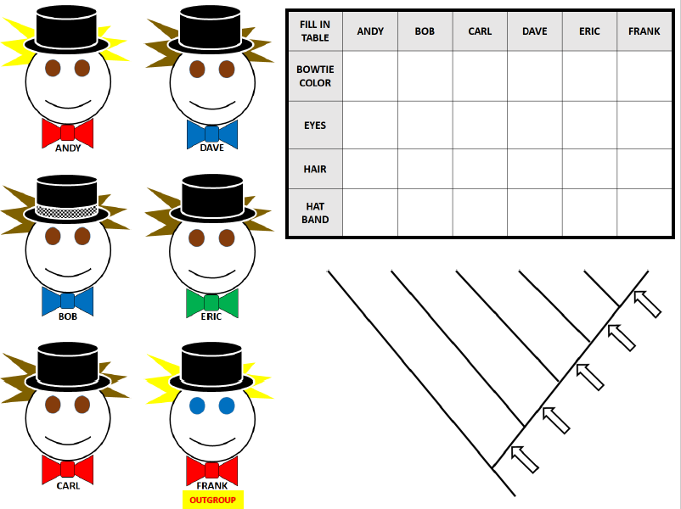

Slide 25
“Practice Cladogram”
(possible bonus on EXAM 2)
HANDOUT
Notes:
Use new PowerPoint file “Tree Building Exercise Example Men In Hats”

Slide 26
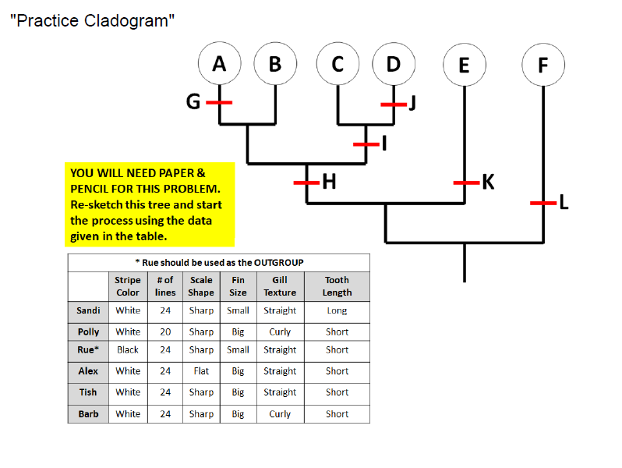
ANSWERS ARE ENTERED USING LINK IN MOODLE

Slide 27
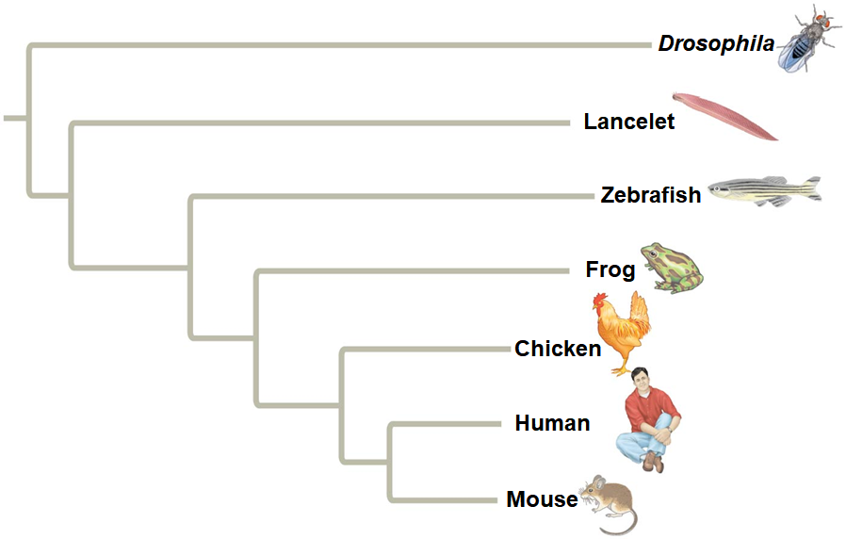
Phylogenetic Trees with Proportional Branch Lengths
In some trees, the length of a branch can reflect the number of genetic changes that have taken place in a
  EX: the longer the branch lengths connecting two organisms, more
  Which would have more genetic changes: comparing chicken vs. human -OR- human vs. mouse?
Notes:
Figure 26.13 Branch lengths can represent genetic change.

Slide 28
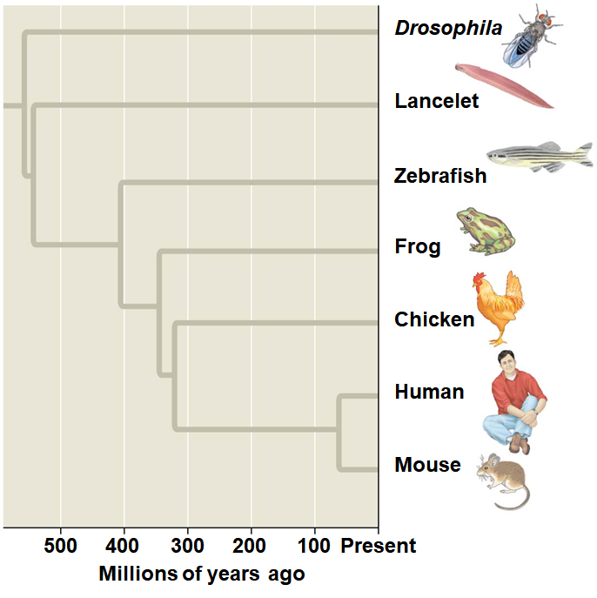
24
In other trees, branch length can be proportional to time, and branching points can be determined from the
Which organism is the most ancient here?
How many EXTANT species?
Notes:
Figure 26.14 Branch lengths can indicate time.

Slide 29
Maximum Parsimony and Maximum Likelihood
Systematists can never be sure of finding the
They narrow possibilities by applying the principles of
Maximum parsimony assumes that the tree that requires the
Maximum likelihood is based on probability rules about how DNA changes over time (i.e. mutations) and assumes a tree can be found

Slide 30
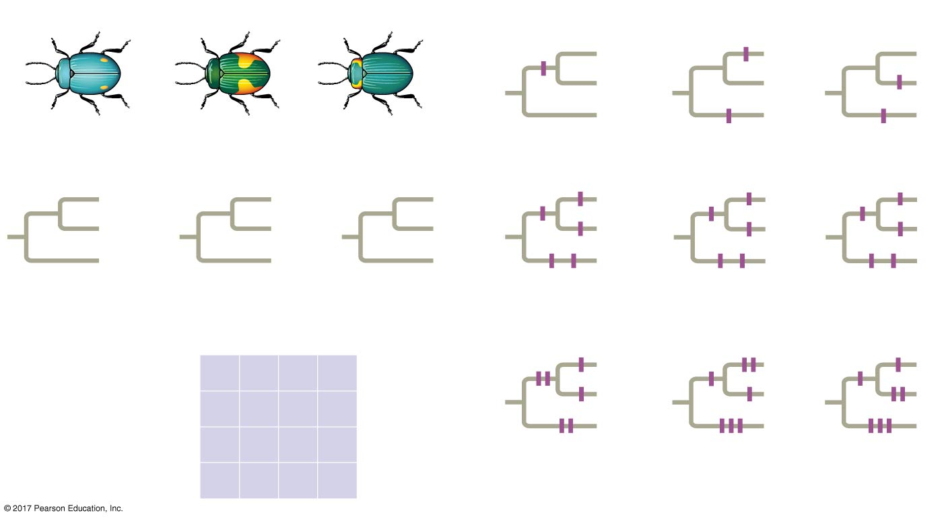
26
Applying parsimony to a problem in molecular systematics
Technique
3
I
1/C
I
III
1/C
II
III
II
III
II
1/C
I
Species I
Species II
Species III
1/C
1/C
1
Three phylogenetic hypotheses:
4
3/A
2/T
3/A
I
I
III
2/T
I
3/A
I
4/C
III
II
III
II
II
III
II
III
II
I
4/C
III
4/C
II
2/T
I
3/A 4/C
2/T 4/C
2/T 3/A
Site
Results
2
1
2
3
4
Species I
C
T
A
T
I
I
III
Species II
II
III
II
C
T
T
C
III
II
I
Species III
A
G
A
C
6 events
7 events
7 events
Ancestral sequence
A
G
T
T
So which two species would be more closely related using this approach?
Notes:
Figure 26.15 Research method: applying parsimony to a problem in molecular systematics
Figure 26.15a Research method: applying parsimony to a problem in molecular systematics (part 1: three possible trees)
Figure 26.15b Research method: applying parsimony to a problem in molecular systematics (part 2: table)
Figure 26.15c Research method: applying parsimony to a problem in molecular systematics (part 3: comparison)
Figure 26.15d Research method: applying parsimony to a problem in molecular systematics (part 4: results)

Slide 31
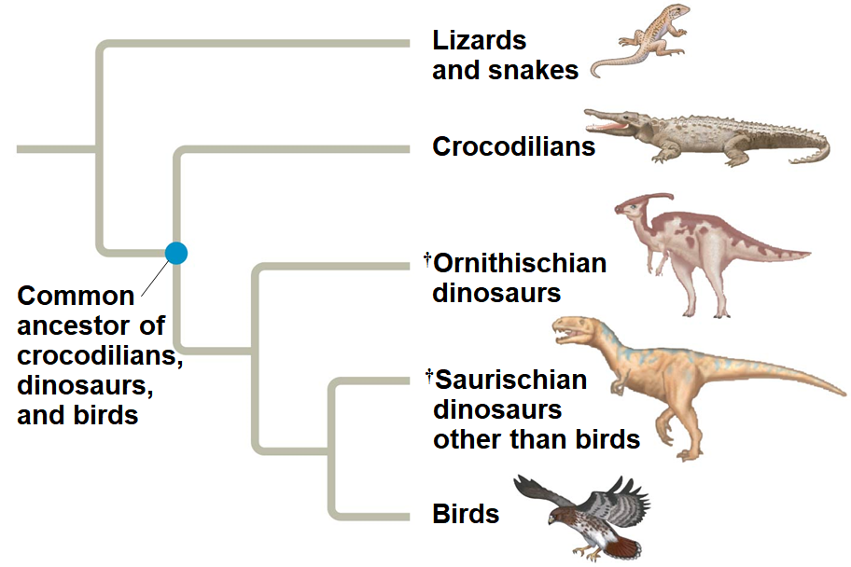
Phylogenetic Trees as Hypotheses
The best hypothesis for a phylogenetic tree fits the most data:
Phylogenetic bracketing allows us to predict features of an
  EX: phylogenetic bracketing allows us to

Slide 32
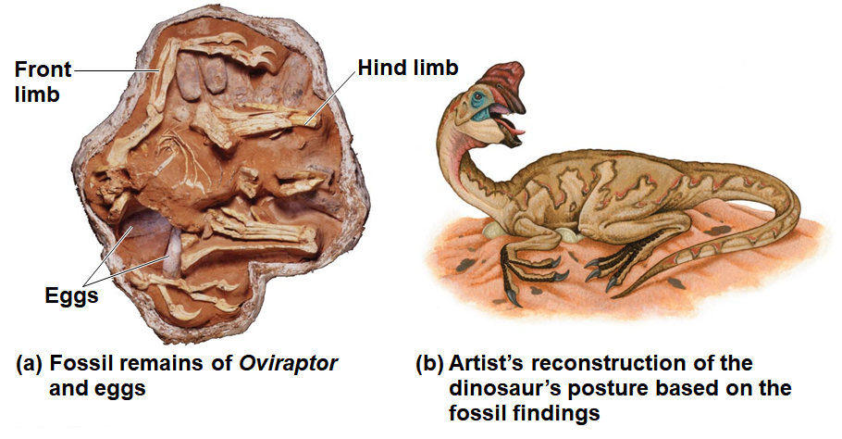
28
Birds and crocodiles share several features:
These features likely evolved in a common ancestor and were shared by
The fossil record supports
Notes:
Figure 26.17 Fossil support for a phylogenetic prediction: Dinosaurs built nests and brooded their eggs

Slide 33
Concept 26.4: An organism’s evolutionary history is documented in its genome
Comparing nucleic acids or other molecules to infer relatedness is a valuable approach for
DNA that codes for rRNA changes relatively slowly and is useful for investigating branching points that diverged
mtDNA evolves rapidly and can be used to
  mutation rate is
  subject to
  lacks the DNA

Slide 34
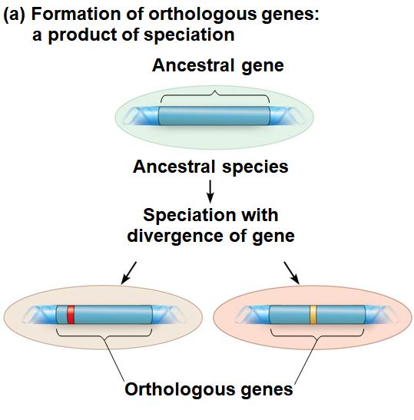
Gene Duplications and Gene Families
Gene duplication increases the number of genes in the genome, providing more
Repeated gene duplications result in
Duplicated genes can be traced to a
Orthologous genes are found in a single copy in the genome and are
They can diverge only
Notes:
Figure 26.18 Two types of homologous genes

Slide 35
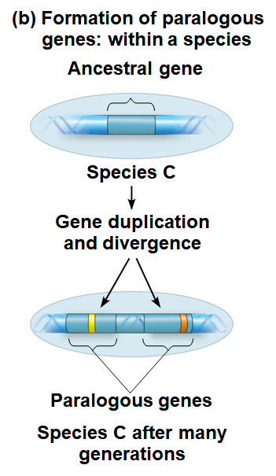
31
Paralogous genes result from gene duplication so are found in
They can diverge within the species that carries them and
Notes:
Figure 26.18 Two types of homologous genes

Slide 36
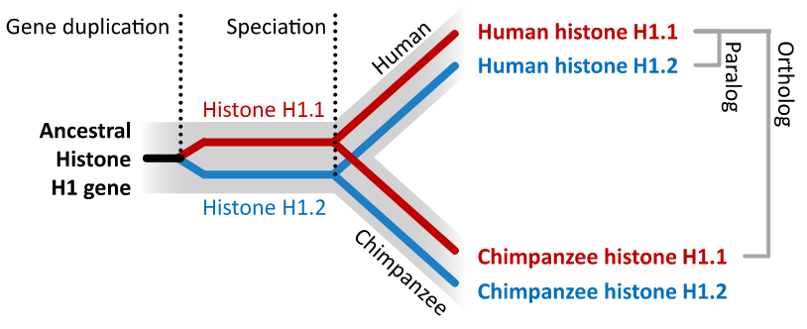
Orthologous vs. Paralogous genes example
Orthologous genes are found in different organisms, but are derived from a single common ancestral gene present
Paralogous genes are genes present in a particular organism that are related to each other
Below is an example using the HISTONE gene

Slide 37
Genome Evolution
Orthologous genes are widespread and extend across
  EX: humans and mice diverged about
Gene number and the complexity of an organism are not
  EX: humans have only four times as many genes as
Genes in complex organisms appear to be very versatile, and each gene can

Slide 38
Concept 26.5: Molecular clocks help track evolutionary time
To extend phylogenies beyond the fossil record, we must make an
A molecular clock uses constant rates of evolution in some genes to
In orthologous genes, nucleotide substitutions are assumed to be
In paralogous genes, nucleotide substitutions are proportional to the

Slide 39
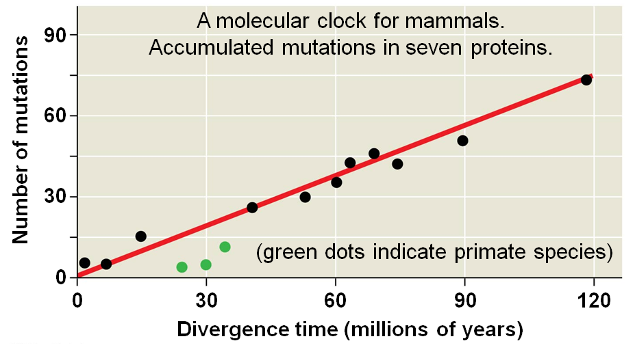
34
Molecular clocks are calibrated against branches whose dates
Individual genes
Primate proteins appear to have
Notes:
Figure 26.19 A molecular clock for mammals

Slide 40
Differences and Problems in Clock Speed
If most of the evolutionary change has no effect on fitness, then
Differences in clock rate for different genes are a function of the importance of the gene and how critical the
The molecular clock does not run as smoothly as expected if
Irregularities result from
Estimates of evolutionary divergences older than the fossil record have a
The use of multiple genes or genes that evolved in different

Slide 41
Applying a Molecular Clock: Dating the Origin of HIV
Phylogenetic analysis shows that HIV is descended from
HIV spread to
Comparison of HIV samples shows that the virus evolved in a
Application of a molecular clock to one strain of HIV suggests that the strain spread to
A more advanced molecular clock approach estimated

Slide 42
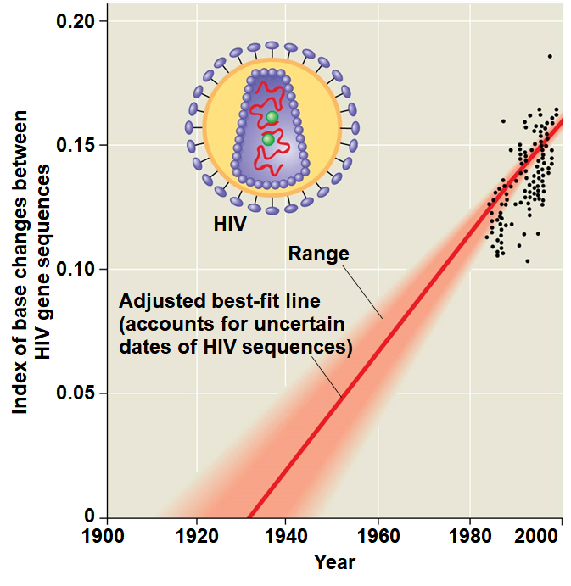
Figure 26.20
Notes:
Figure 26.20 Dating the origin of HIV-1 M

Slide 43
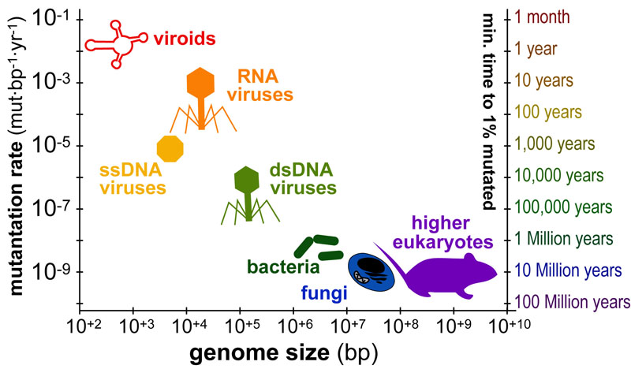
Scales at which Organisms “Mutate” or “Evolve”
So…What is the “take away” message here?
The timescales over which organisms “mutate” or “evolve” vary dramatically from months (viruses) to millions of years (animals). The figure above plots the average genome size in base-pairs (x-axis) versus the average mutation-rate(y-axis) for various organisms. In addition, a second y-axis (“minimum time to 1% mutation”) illustrate approximate timescales corresponding to each rate.

Slide 44
Concept 26.6: Our understanding of the tree of life continues to change based on new data
Recently, we have gained insight into the very deepest branches of the
Early taxonomists classified all
Later, five kingdoms were recognized:
More recently, the three-domain system has been adopted:
The three-domain system is

Slide 45
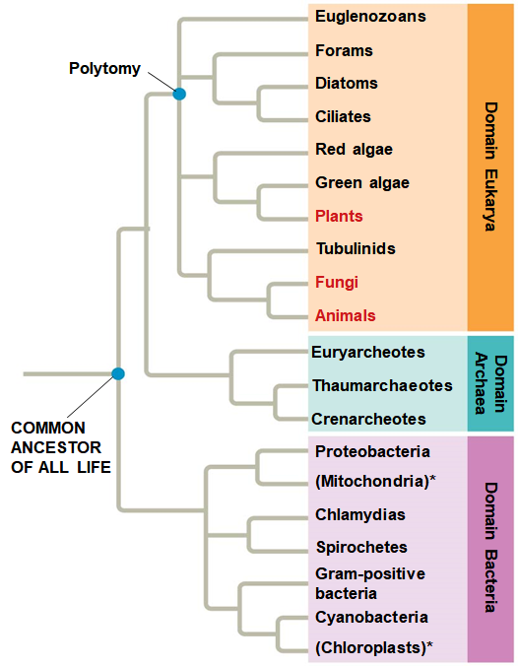
Figure 26.21
Eukarya
vs.
Archaea
Archaea
vs.
Bacteria
Notes:
Figure 26.21 The three domains of life

Slide 46
The Important Role of Horizontal Gene Transfer
The tree of life suggests that eukaryotes and archaea are more
The tree of life is based largely on rRNA genes; but, some
There have been substantial interchanges of genes between
Horizontal gene transfer is the
Horizontal gene transfer occurs by exchange of transposable elements and

Slide 47
41
Disparities between gene trees can be explained by the
Horizontal gene transfer has played a key role in the evolution of
Eukaryotes can acquire nuclear genes from
  EX: the alga Galdieria sulphuraria acquired about 5% of its genes from
Some biologists argue that horizontal gene transfer was so common, early life history should be shown as a
Bottom Line: Determining precise relatedness among organisms can be

Slide 48
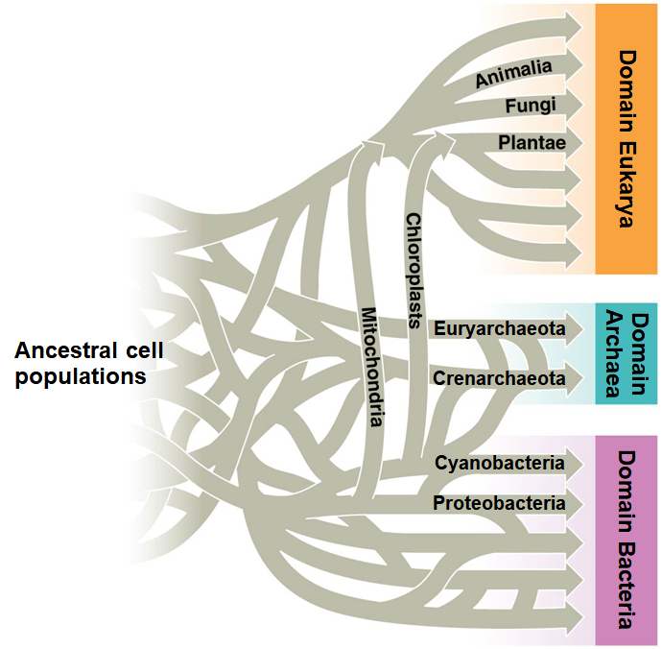
Figure 26.23
Notes:
Figure 26.23 A tangled web of life

